Slide 1
Apply Procedures to Develop Message, Input, and Dialog Boxes
Computer Programming I
Summer 2011

Slide 2
Objective/Essential Standard
Essential Standard 6.00Apply tools to obtain and validate user input.
Indicator 6.02 Apply Procedures to Develop Message, Input, and Dialog Boxes. (4%)

Slide 3
Message, Input, and Windows Forms
Message, input and Windows forms increase the interactivity of your application.
They allows the user to interface with your application.
In this presentation we will look at how to add these new control objects to your application.

Slide 4
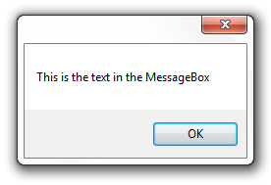
The MessageBox Control
The MessageBox is a predefined dialog box that displays information to the user.
Notes:
This control was introduced in 5.02. It is covered in more detail here.

Slide 5
The MessageBox Control
The following code demonstrates how to use the Show method of the MessageBox class to display a message to the user.
Private Sub btnMsgBox_Click(ByVal sender As System.Object, ByVal e As System.EventArgs) Handles btnMsgBox.Click
MessageBox.Show("This is the text in the MessageBox")
End Sub
You must have the parentheses.
You must also have the quotation marks because this is a string.

Slide 6
The Message Box Control
MessageBoxButtons- choose which buttons are available.
MessageBoxIcon - set up an icon (picture) to show.
DialogResult - which button the user clicked can be checked using an IF statement.
IF MessageBox.Show(“Exit, Abort or Retry?”,
“Choose”, MessageBoxButtons.AbortRetryIgnore,
MessageBoxIcon.Question) = DialogResult.Abort
THEN
Application.Exit()
ENDIF
Rule: all parameters (parts in parentheses) must be IN ORDER and none skipped.

Slide 7
The MessageBox Control
You can display a message box to request information.
There are options available with the MessageBoxButtons that allow you to offer to the user more options.
MessageBoxButtons.AbortRetryIgnore
MessageBoxButtons.OK
MessageBoxButtons.OKCancel
MessageBoxButtons.RetryCancel
MessageBoxButtons.YesNo
MessageBoxButtons.YesNoCancel
You can compare the user’s choice with the DialogResult.

Slide 8
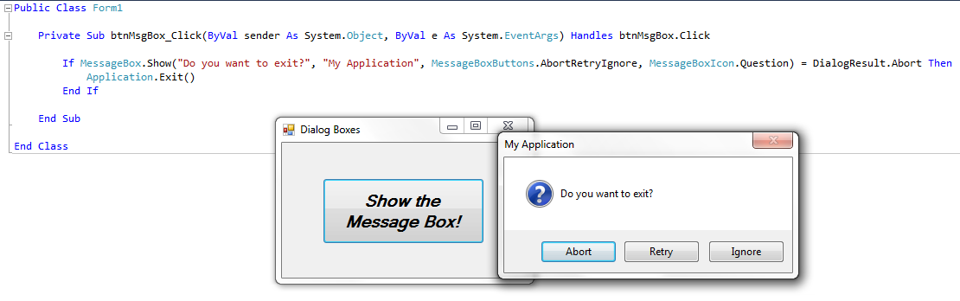
The MessageBox Control

Slide 9
InputBox Function
Computer programming 1

Slide 10
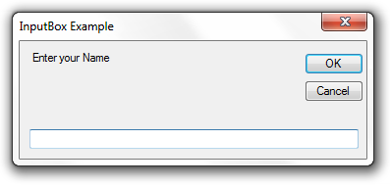
The InputBox Function
The input box is a function that allows a user to input information.
It displays a prompt in a dialog box, waits for the user to either hit the enter key or click a button, then returns the information from the textbox as a string.
Title
Prompt

Slide 11
The InputBox Function
There is one required parameter, the Prompt. You will need to add a prompt that will be displayed at the top of the dialog box.
The Title parameter, while set up with a default of nothing, should be set. The title is displayed in the title bar at the top of the dialog box.
Note that there are additional optional parameters.
XPos, YPos
These set the position where the input box will be displayed.

Slide 12
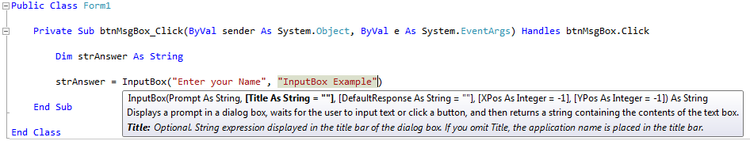
The InputBox Function
This example sets the result of the input box to the string variable strAnswer.
Don’t forget that the input box returns a STRING. If you want to turn this value into a numeric value you will need to convert it.

Slide 13
Adding a New Windows Form
Computer programming 1

Slide 14
Steps to Add a New Windows Form
From the Solution Explorer, right-click on your project, select add, then Windows Form. - or - You can go to the Project menu, select Add Windows Form, then Windows Form.
Name the Form (otherwise it will be Form2 if it will be the second form, otherwise it will be Form3, etc).
Your new form will be displayed in the Design Window.
In the Properties window,
Change the FormBorderStyle property to FixedDialog.
Set the ControlBox, MinimizeBox, and MaximizeBox to false
Customize your form.

Slide 15
Using the New Form
You can use the show and hide your new form using the following commands.
To show the dialog box formName.Show()
To hide the dialog box formName.Hide()
To close the dialog box formName.Close()

Slide 16
Try It!
Create a new application called msgExample.
Save it in the folder as directed by your teacher.
Add a Button control
Properties: Name: btnShow
In your code, do the following
Declare a string variable strName
Using an input box, ask the user to enter his/her first name. Have that entry go into the variable strName.
Using a message box, display the message “Great Job, first name”

Slide 17
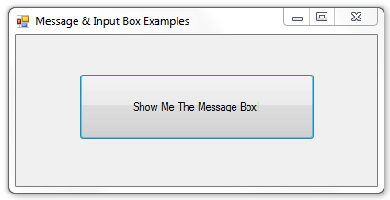
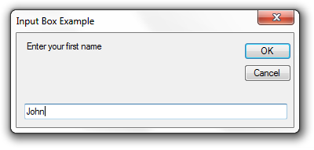
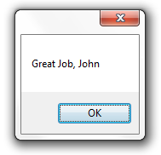
Try It!
Main form
Button Click causes
Input box to be displayed (vb only)
Gets input from user and assigns it to the variable strName
Message box to be displayed.
Displays message, including value of the variable from input.

Slide 18
Try It! Solution
Private Sub btnShow_Click(ByVal sender As System.Object, ByVal e As System.EventArgs) Handles btnShow.Click
'Declare variable for input
Dim strName As String
'Get input from user
strName = InputBox("Enter your first name", "Input Box Example")
'Display output using a message box.
MessageBox.Show("Great Job, " & strName)
End Sub

Slide 19
Conclusion
This PowerPoint provided an overview of adding a message box, input box and dialog box in Visual Studio.
For more information on this topic
http://msdn.microsoft.com/en-us/library/2chz8edb(v=VS.80).aspx
For more information on dialog boxes
http://msdn.microsoft.com/en-us/library/2chz8edb.aspx

